Slide 1
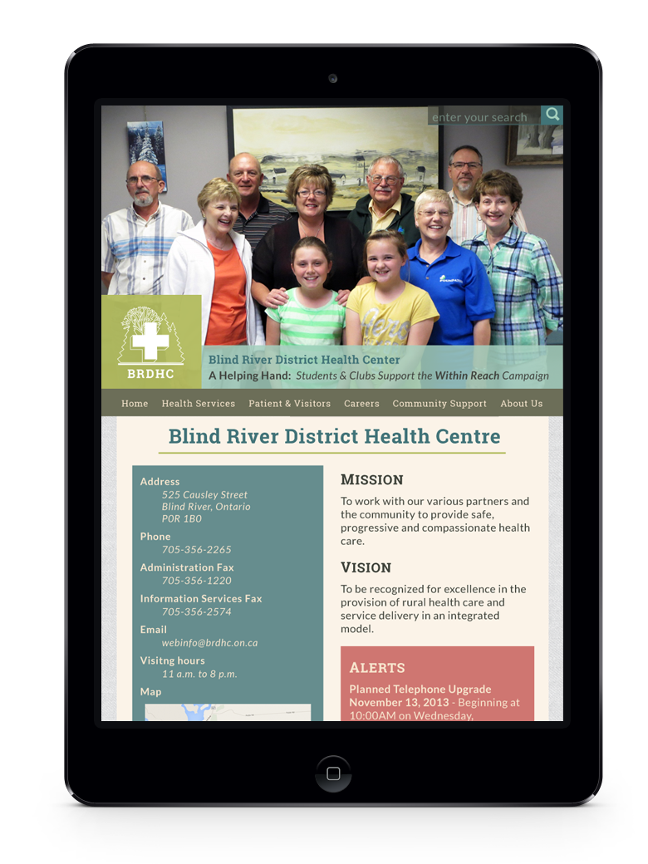
Introduction
Blind River District Health Centre Website Redesign
Team 5:
Shannon – Strategy
Anmar – Back-End
Ben – Content
Navpreet – Interface
Marki - Interface

Slide 2
Understanding Your Needs
Accessibility – Standards are Changing
Content Management System (CMS)
Content Redesign
Responsive Design

Slide 3

Deliverable - CMS
Content Management System (CMS)
A system that manages the content of a website.

Slide 4
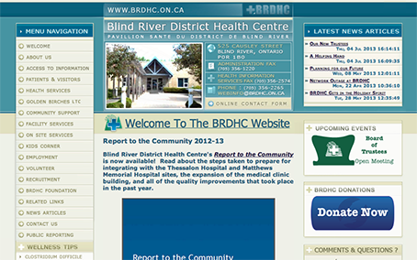
Deliverable - CMS
Content can be broken down into two categories:
1. The information such as text, images, audio and anything you see on a website when you visit it.

Slide 5
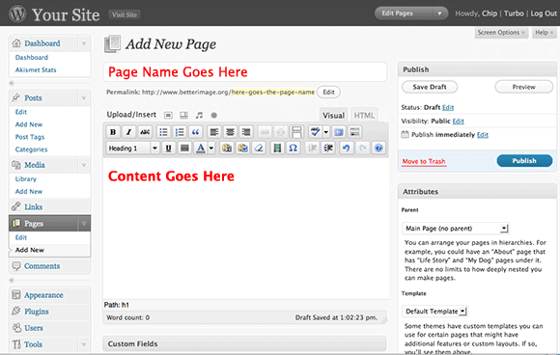
Deliverable - CMS
Content can be broken down into two categories:
2. The applications or software that runs on the website’s servers and displays the information

Slide 6
Deliverable - CMS
CMS Content
The Information
The Application

Slide 7
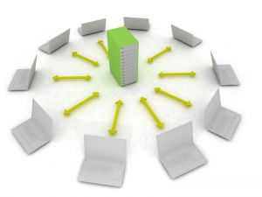
Deliverable - CMS
Where is “content”?
Stored on a server in a place called a database
Server: a centralized computer
Database: is a collection of related data

Slide 8
Deliverable - CMS
The benefit of using a CMS:
No need to install a client software.
Programming knowledge is not required
No delay in updating the website
Website access control
Consistency

Slide 9
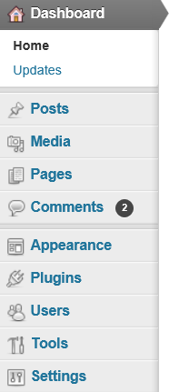
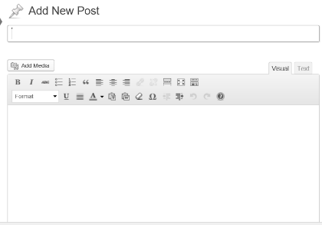
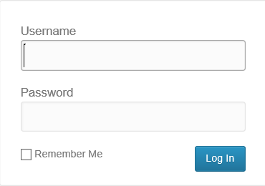
Deliverable - CMS
How to use a CMS?
CMS can be accessed on the internet
Users can create, maintain, update, and remove content

Slide 10
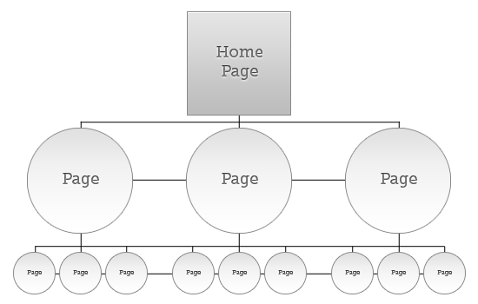
Deliverable – Content Redesign
Information Architecture
Website structure or organization
Relation between different pages
Clear, logical growth

Slide 11
Deliverable – Content Redesign
Benefits to the health centre
Provide better services to community
More donation opportunities
Attract doctors and volunteers
Ownership of the website
Keep content up to date
Reflect changes quickly

Slide 12

Deliverable – Content Redesign
Benefits to website visitors
Find the key information quickly and easily
Consistent and predictable content

Slide 13
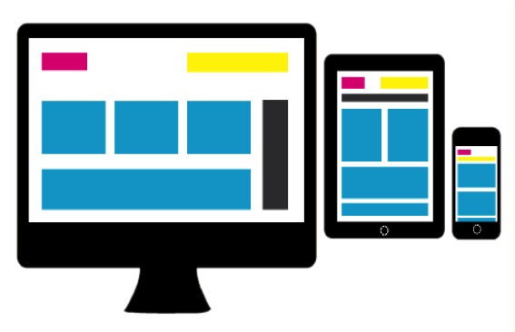
Deliverable - Interface
What is Responsive Web Design (RWD) ?
Allows you to tailor a site’s layout & interfaces to suit various devices.
Adaptable Layout
Content
Functionality

Slide 14
Deliverable - Interface
Present Day Scenario
Different Platforms, Devices
Smart devices increasing quickly
Plenty of users visit websites using mobile

Slide 15
Deliverable - Interface
Advantages
Single URL (http://www.brdhc.on.ca/)
Save time and money
Thousands of potential users

Slide 16
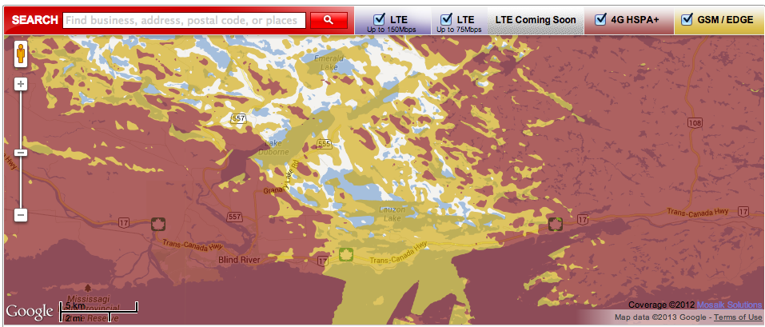
Deliverable - Interface
Blind River

Slide 17
Deliverable - Interface
Websites that are not responsive
Hard to read
Hard to navigate
Takes too long to load
Key information is not displayed prominently

Slide 18
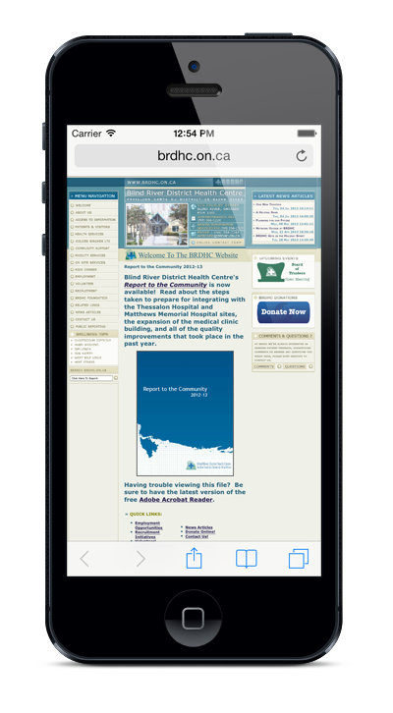
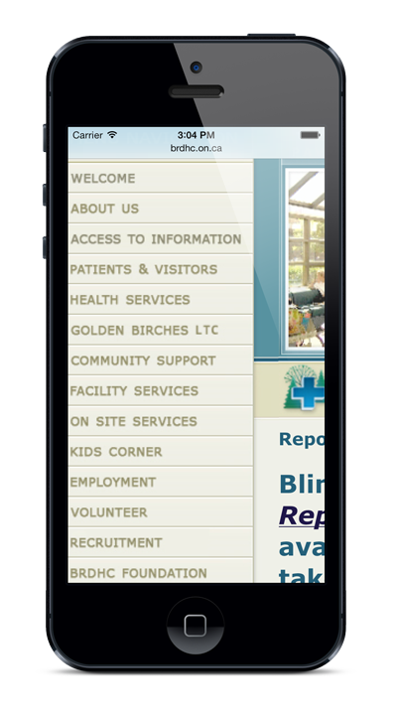
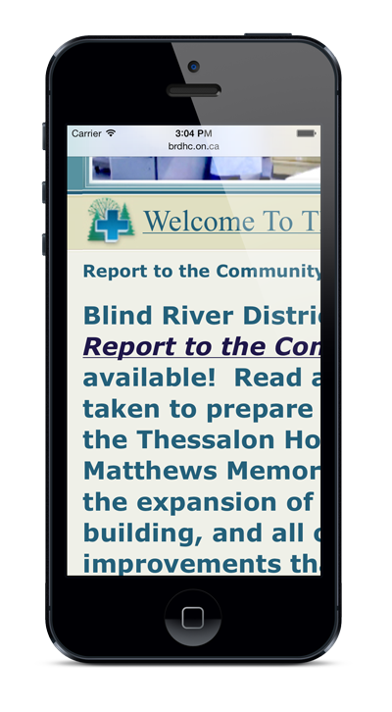
Deliverable - Interface
Just because you can open a site on mobile, does mean it’s mobile friendly

Slide 19
Deliverable - Interface
Critical information is visible for quick response in emergency situations
Careers: recruiting hospital staff

Slide 20
Deliverable - Interface
Future Enhancements
With a responsive website, the MDM solutions are easily incorporated
BYOD solutions are simple to implement

Slide 21
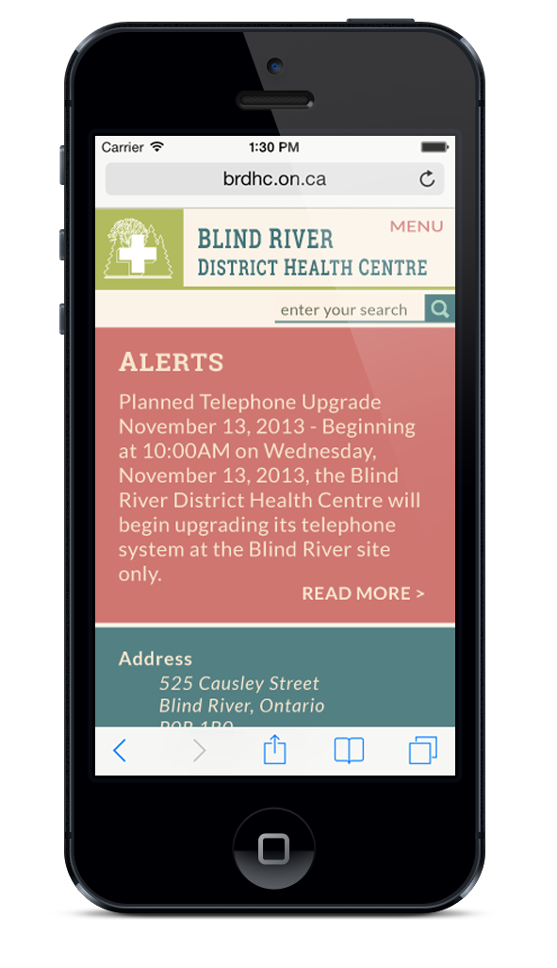
Deliverable - Interface

Slide 22
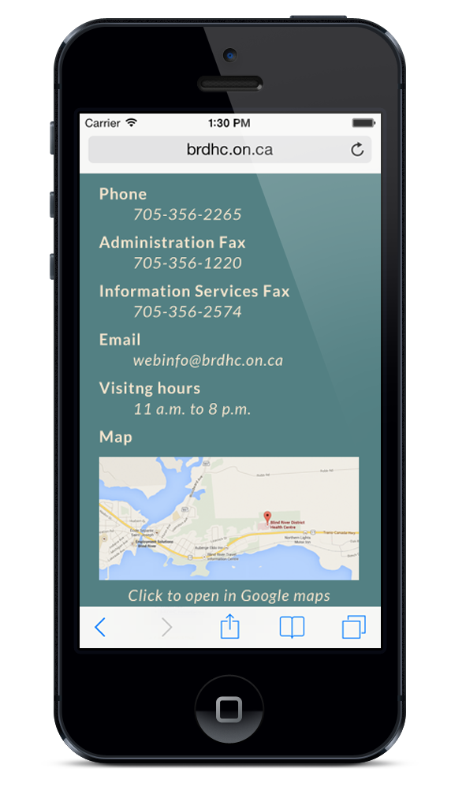
Deliverable - Interface

Slide 23
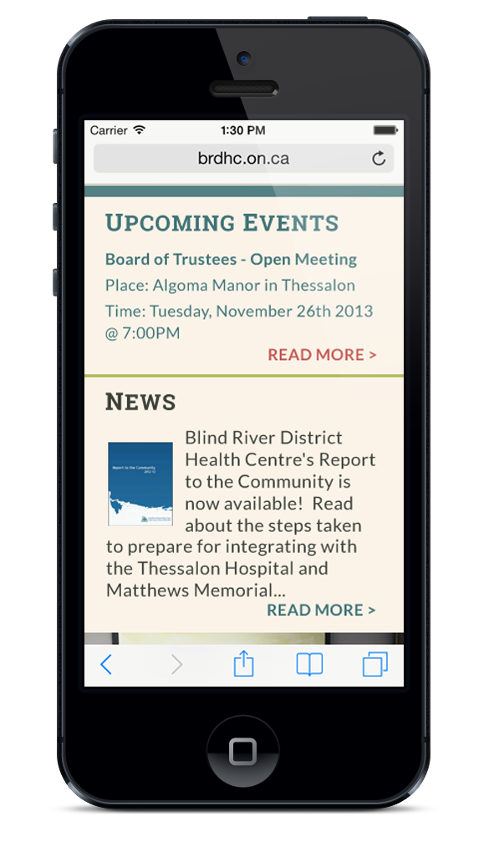
Deliverable - Interface

Slide 24
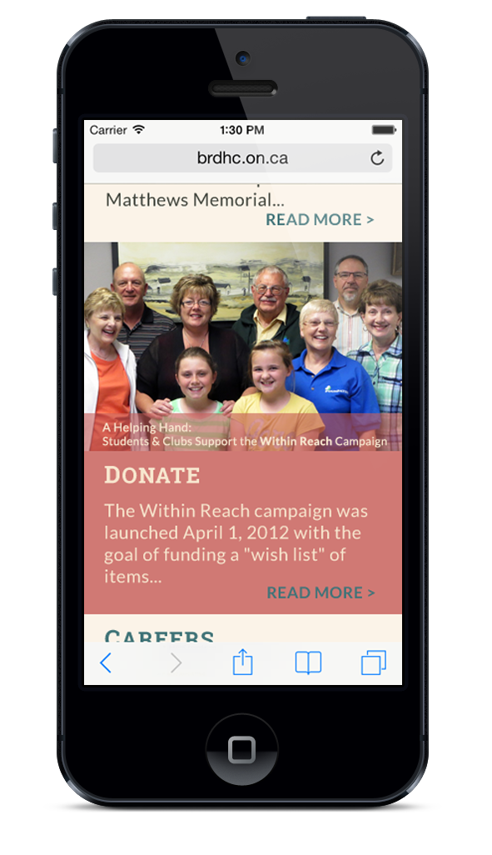
Deliverable - Interface

Slide 25
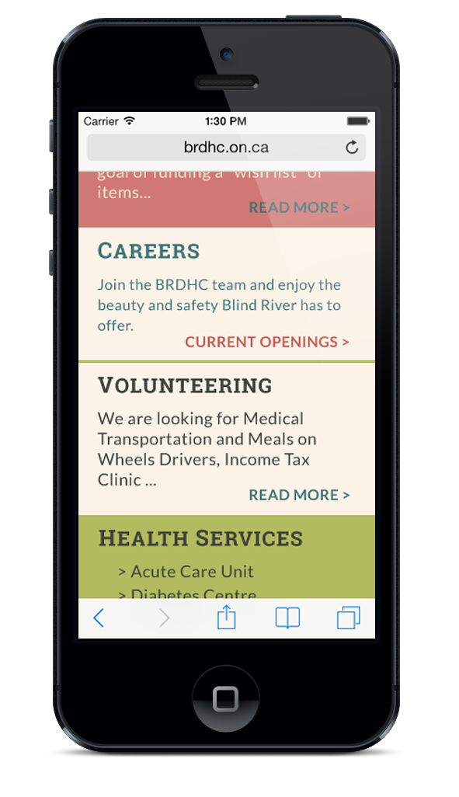
Deliverable - Interface

Slide 26
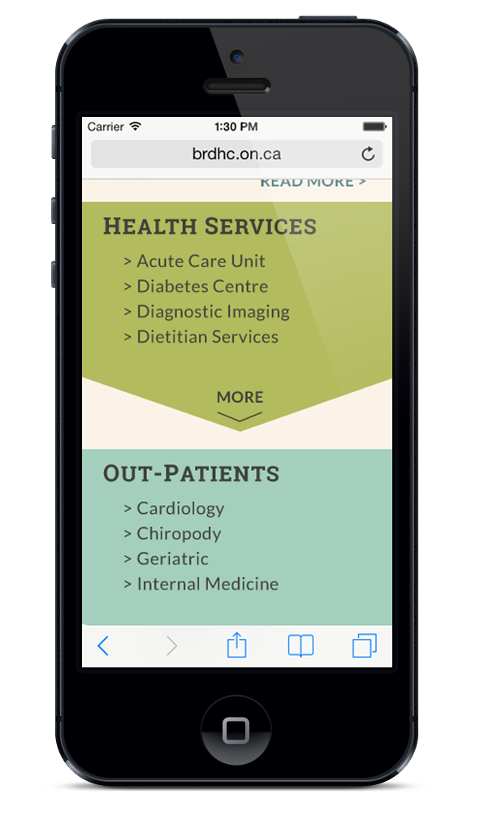
Deliverable - Interface

Slide 27
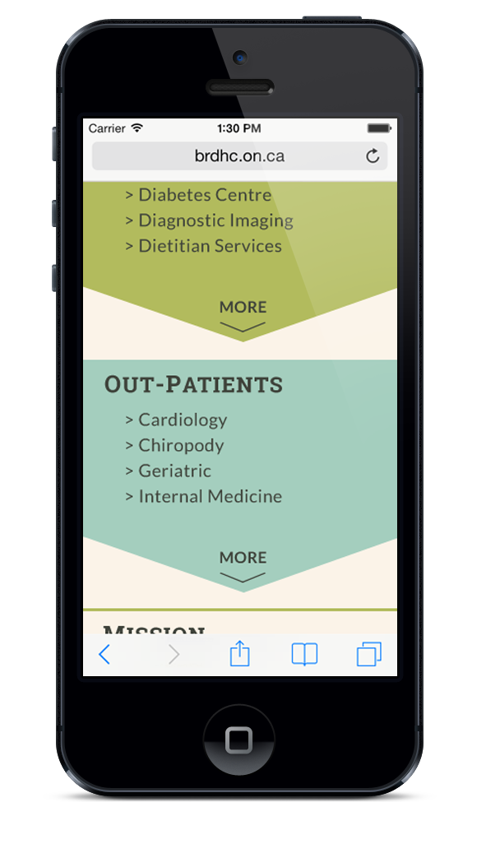
Deliverable - Interface

Slide 28
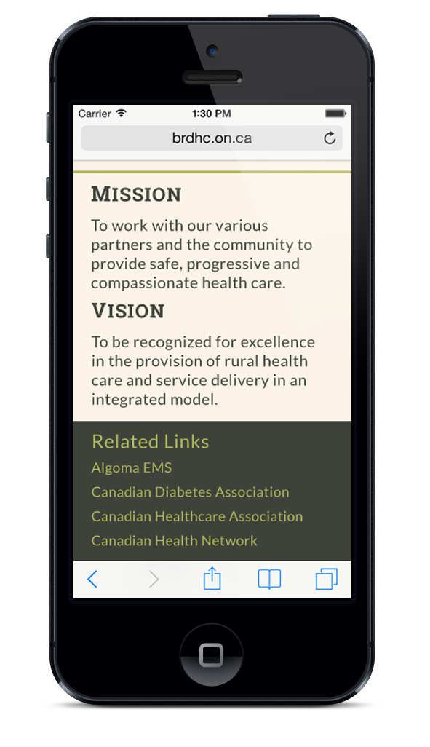
Deliverable - Interface

Slide 29
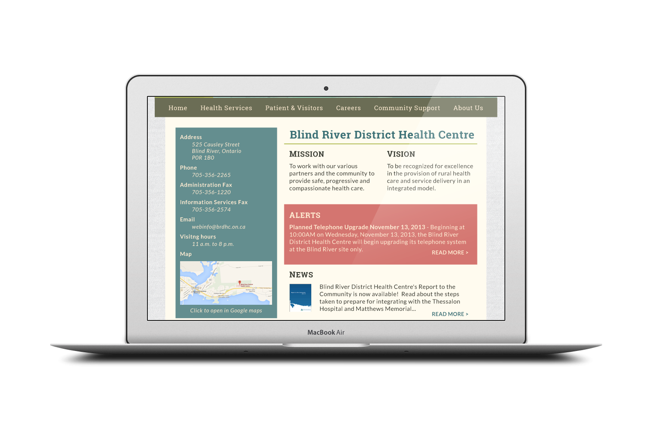
Deliverable - Interface

Slide 30
Deliverable - Interface

Slide 31
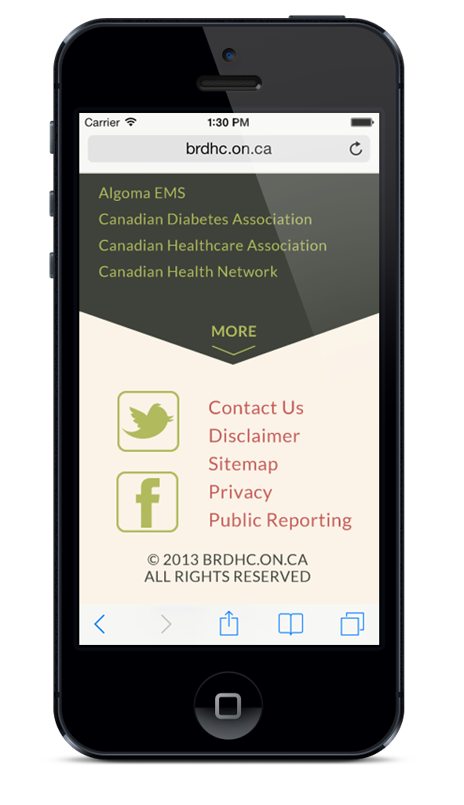
Deliverable - Interface

Slide 32
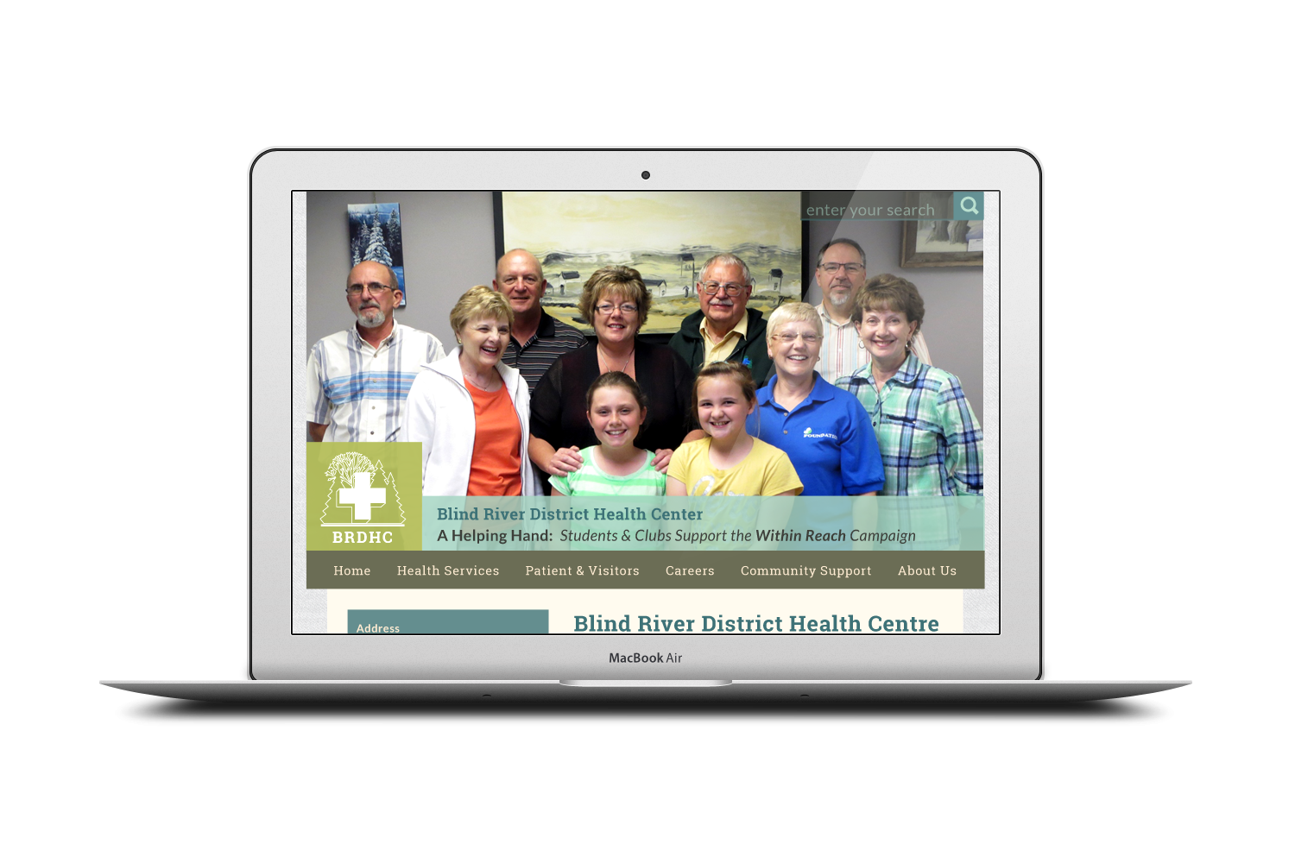
Deliverable - Interface

Slide 33
Deliverable - Interface

Slide 34
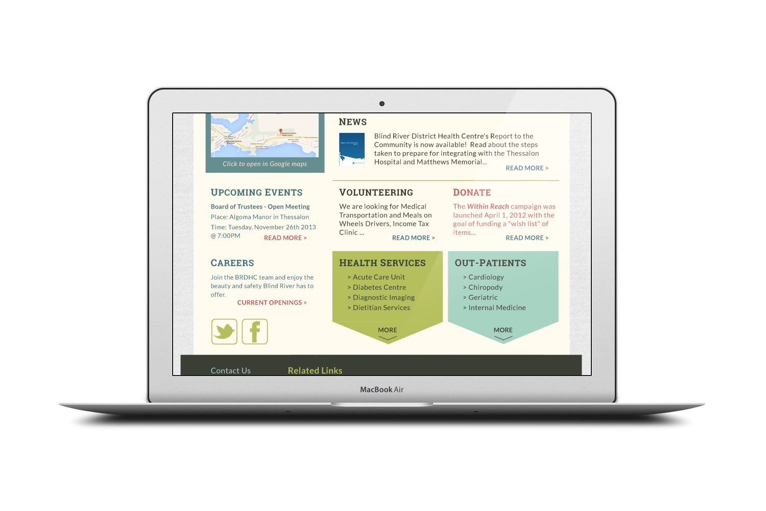
Deliverable - Interface

Slide 35
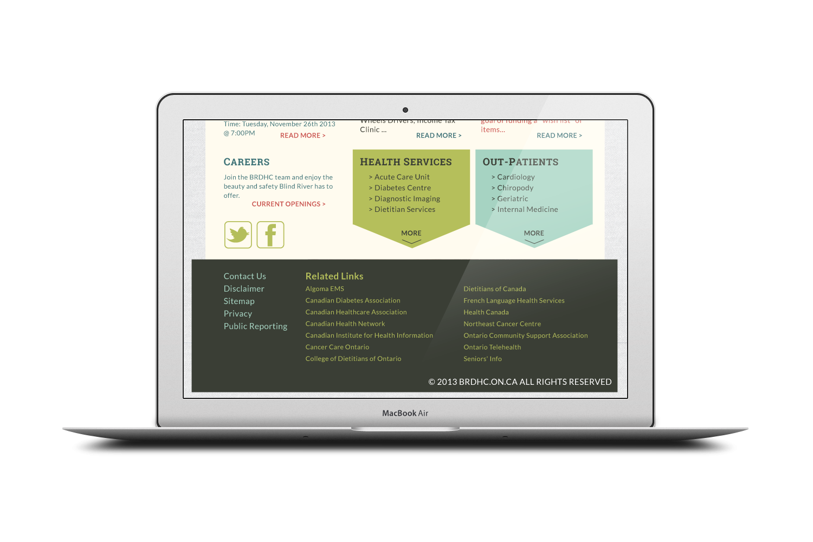
Deliverable - Interface

Slide 36
Deliverable - Interface

Slide 37
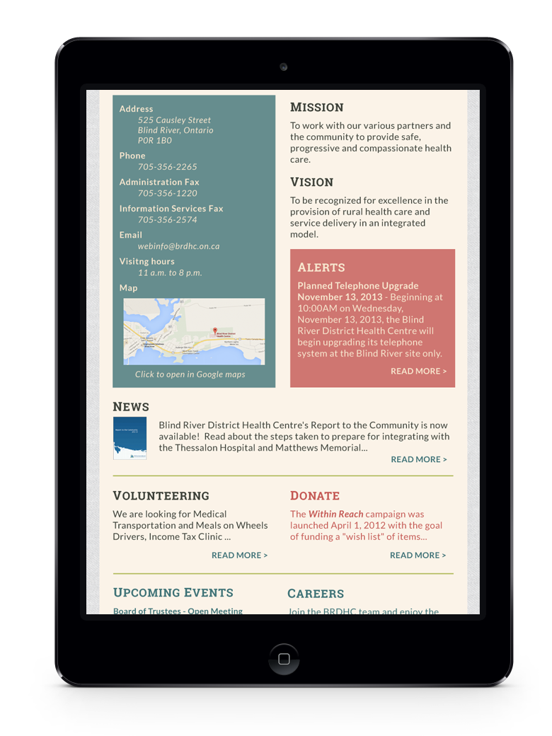
Deliverable - Interface

Slide 38
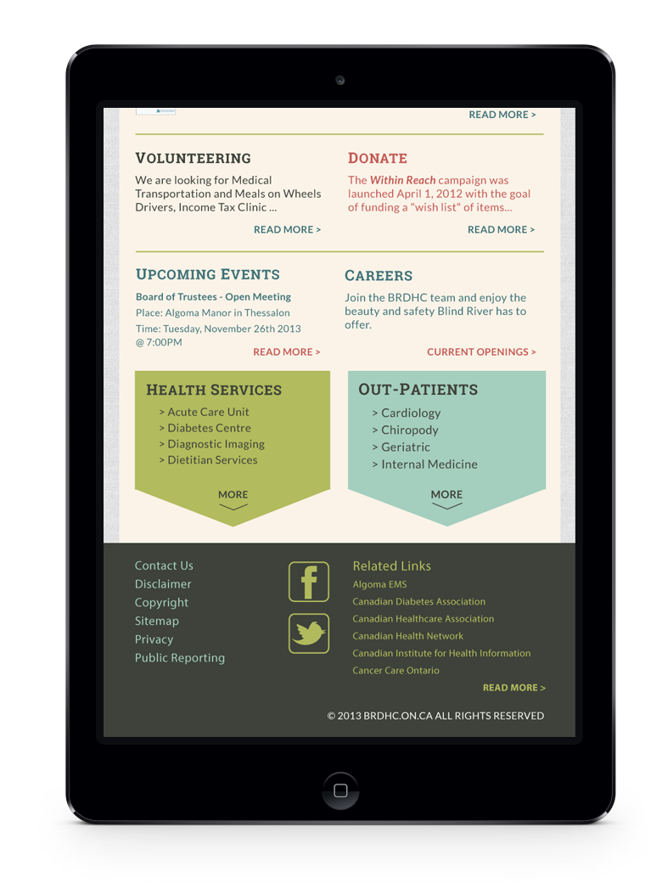
Deliverable - Interface

Slide 39
Timeline
Define information architecture
Design user interface and features
Prepare content
Programming
Load content
Training and launch

Slide 40
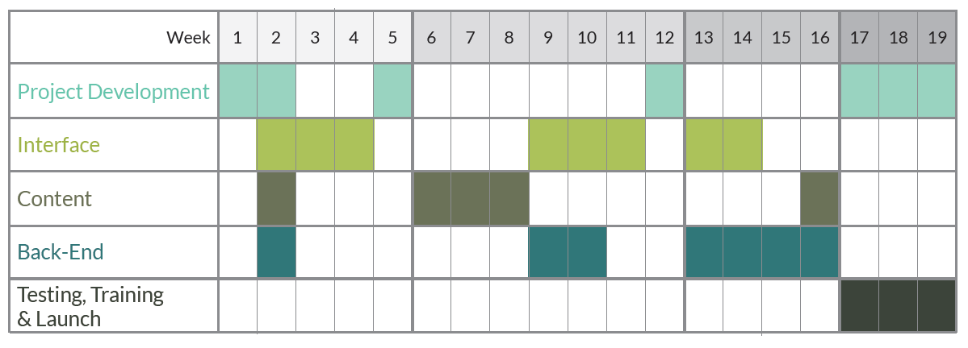
Schedule

Slide 41
Schedule
Discover

Slide 42
Schedule
Define & Design

Slide 43
Schedule
Develop

Slide 44
Schedule
Deploy!

Slide 45
Conclusion
Opportunities for the Hospital
Accessible design – AODA compliant
Ease and clarity with content redesign
Responsive to all devices
Control with CMS

Slide 46
THANK YOU!
Blind River District Health Centre

